Slide 1
Mitigating the Threat of Keyloggers: Safeguarding Against Stealthy Keystroke Monitoring in the Digital Age
Presented By:
Subashree S R -College of Engineering , Guindy-Department of Information Science and Technology

Slide 2
OUTLINE
Problem Statement
Proposed System/Solution
System Development Approach
Algorithm & Deployment
Result
Conclusion
Future Scope
References

Slide 3
Problem Statement
In today's digital age, where cybersecurity threats loom large, one of the significant concerns is the proliferation of keyloggers, stealthy software tools designed to monitor and record keystrokes on a user's computer without their knowledge. Keyloggers pose a severe threat to individuals and organizations as they can capture sensitive information such as passwords, credit card details, and other personal data, leading to identity theft, financial loss, and privacy breaches.

Slide 4
Proposed Solution
The proposed solution aims to create a comprehensive and insightful demonstration of Python keylogger functionality using the tkinter and pynput libraries. This demonstration serves to illustrate the potential for keyloggers to be implemented and exploited for malicious purposes, shedding light on the critical importance of cybersecurity in today's digital landscape. Additionally, the report will delve into in-depth discussions regarding robust measures designed to both detect and prevent keylogger attacks. By enhancing cybersecurity awareness and fortifying protective measures, this solution seeks to bolster organizational defenses against keylogger threats, ultimately safeguarding sensitive information and preserving the integrity of digital systems.

Slide 5
System Approach
System Requirements:
Python programming environment with version 3.x installed.
Required libraries: tkinter and pynput.
Operating system compatibility: Windows, macOS, Linux.
Libraries Required to Build the Model:
tkinter: Used for creating the graphical user interface (GUI) elements in the keylogger.py script.
pynput: Essential for capturing keyboard inputs and managing key events (presses, holds, releases) in real-time.

Slide 6
Algorithm & Deployment
The chosen algorithm for keylogger.py is based on event-driven programming using the tkinter and pynput libraries. This approach focuses on capturing keyboard events such as key presses, holds, and releases in real-time, enabling comprehensive logging of keystrokes.
Data Input:
The input features for the keylogger algorithm include:
1. Keyboard events: Captured using the pynput library, including key presses, holds, and releases.
2. Timestamps: Recorded for each key event to track the sequence and timing of keystrokes.
3. Logging options: Specify whether to log keystrokes in a text file ('key_log.txt') or a JSON file ('key_log.json').
Training Process:
As the keylogger algorithm is event-driven and does not involve traditional machine learning training, there is no formal training process. The algorithm is initialized with the necessary libraries and variables, and it continuously monitors keyboard inputs, logging events based on user actions.
Prediction Process:
The keylogger algorithm does not involve prediction or forecasting as it focuses on real-time monitoring and logging of keystrokes. However, the prediction process can be conceptualized as the algorithm's ability to anticipate and capture keyboard events as they occur, providing a chronological record of user interactions with the keyboard.
Real-time Data Inputs:
During the logging and monitoring phase, the keylogger algorithm considers real-time keyboard inputs from the user. This includes capturing key events such as typing, holding keys, and releasing keys, providing a dynamic and up-to-date log of keystrokes.

Slide 7
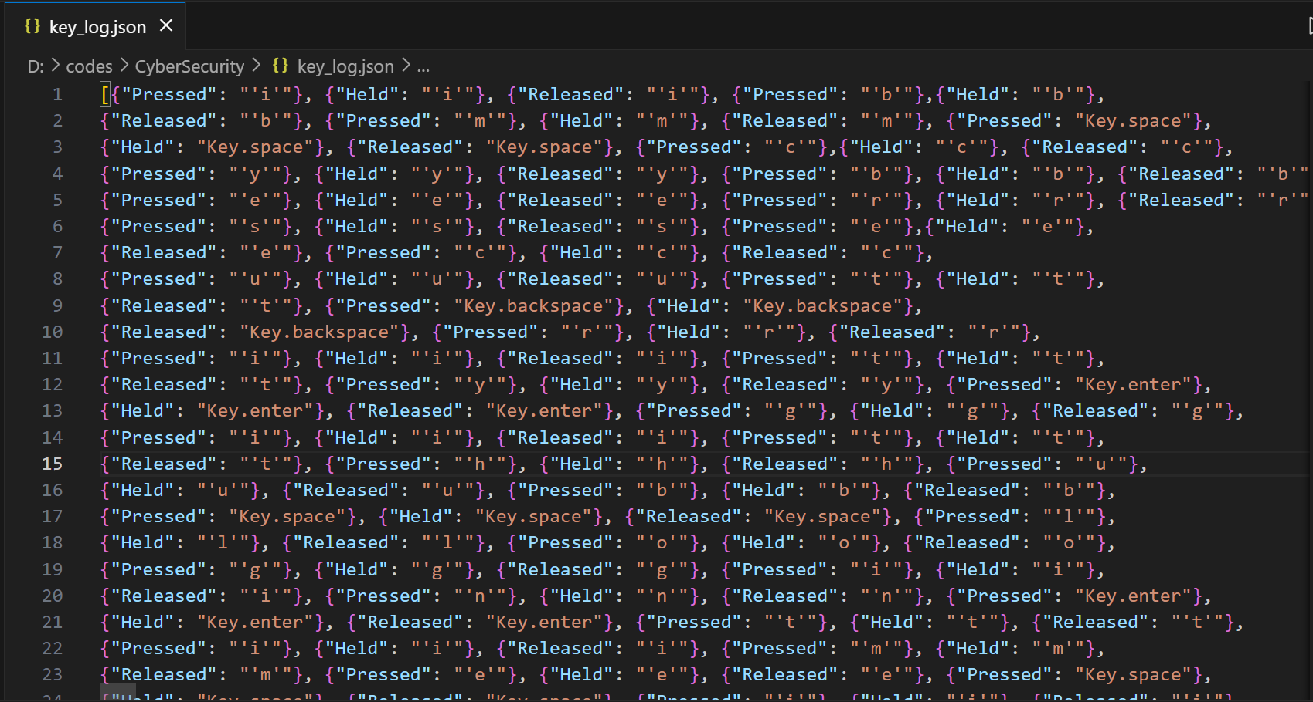
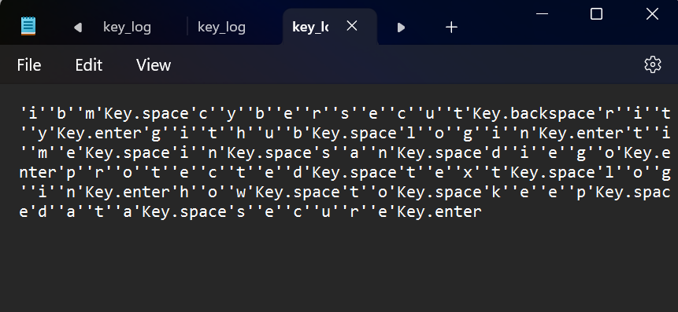
Result
The output of keylogger.py are two file. They are:
key_log.txt Key_log.json

Slide 8
Conclusion
The implementation of the keylogger.py script successfully demonstrated the functionality of capturing and logging keyboard events in real-time using the tkinter and pynput libraries. The keylogger algorithm effectively distinguished between key presses, holds, and releases, providing a comprehensive logging mechanism for user interactions with the keyboard.
Findings and Effectiveness:
The keylogger.py script effectively showcased the potential of keyloggers as monitoring tools but also highlighted their potential misuse for malicious purposes. By logging keystrokes in either a text file or a JSON file, the script provided insights into user interactions with the keyboard, emphasizing the importance of cybersecurity awareness and protective measures against keylogger attacks.
Challenges Encountered:
One challenge encountered during implementation was ensuring compatibility and functionality across different operating systems (Windows, macOS, Linux) due to potential differences in library dependencies and system configurations. Additionally, managing the logging process and preventing unintended data leaks posed a challenge in maintaining user privacy and data security.
Potential Improvements:
To enhance the keylogger.py script, potential improvements include:
Implementing encryption for logged data to protect sensitive information.
Adding functionality for automatic log file rotation to manage file size and storage.
Incorporating user authentication and access controls to restrict log file access.
Enhancing GUI elements for user interaction and customization options.

Slide 9
Future scope
Additional Data Sources:
Capture mouse movements, application usage, and browser activities.
Integrate browser monitoring for website visits and form submissions.
Algorithm Optimization:
Implement efficient data processing and parallel processing techniques.
Explore asynchronous logging for improved performance.
Multi-city Coverage:
Extend keylogger functionality to multiple cities or regions.
Develop centralized logging for aggregated data analysis.
Emerging Technologies Integration:
Integrate edge computing for local data processing and reduced latency.
Incorporate anomaly detection algorithms using advanced machine learning.
Privacy and Security Focus:
Encrypt logged data for user privacy and security.
Implement user authentication and access controls.
Customization Options:
Provide logging customization for format, intervals, and filters.
Enable real-time monitoring and alerts for suspicious activities.

Slide 10
References
Python Documentation: https://docs.python.org/3/
tkinter Library: https://docs.python.org/3/library/tkinter.html
pynput Library: https://pynput.readthedocs.io/en/latest/
Cybersecurity Best Practices: https://www.cisa.gov/cybersecurity-best-practices

Slide 11
THANK YOU

